Slide 1
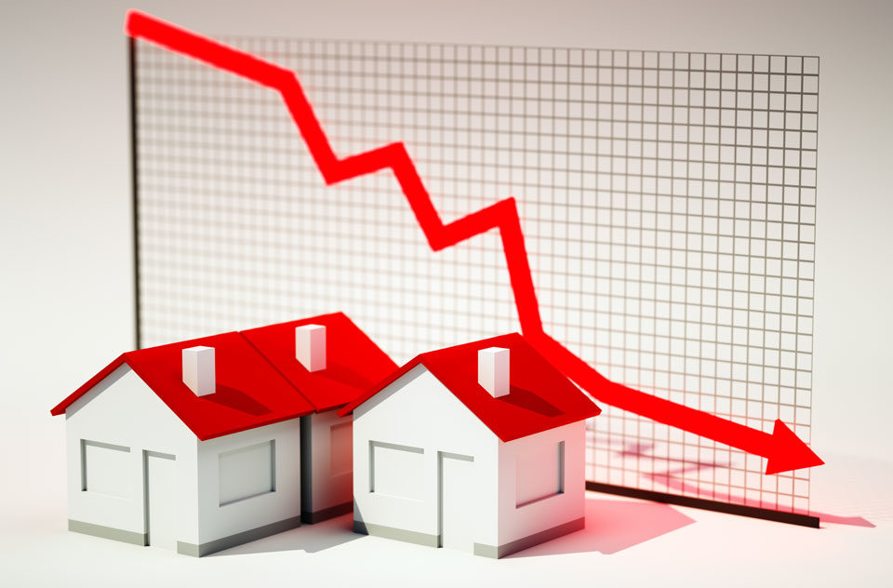
German House Prices Prediction
Prepared by
Abdullah Almutairi

Slide 2
Overview
Introduction
Data cleaning
EDA
Modeling

Slide 3
Introduction
Accurately estimating the value of real estate is an important problem for many stakeholders including house owners, house buyers, agents, and investors. It is also a difficult one.
The goal is to help us understand the relationship between house features and how these variables are used to predict house price.

Slide 4
Data Cleaning
3
4
drop duplicates data
fill object columns by mode
1
2
drop columns with more than 30% missing values
fill numerical column by mean

Slide 5

Dataset
From
10552
25
Observation
Features

Slide 6
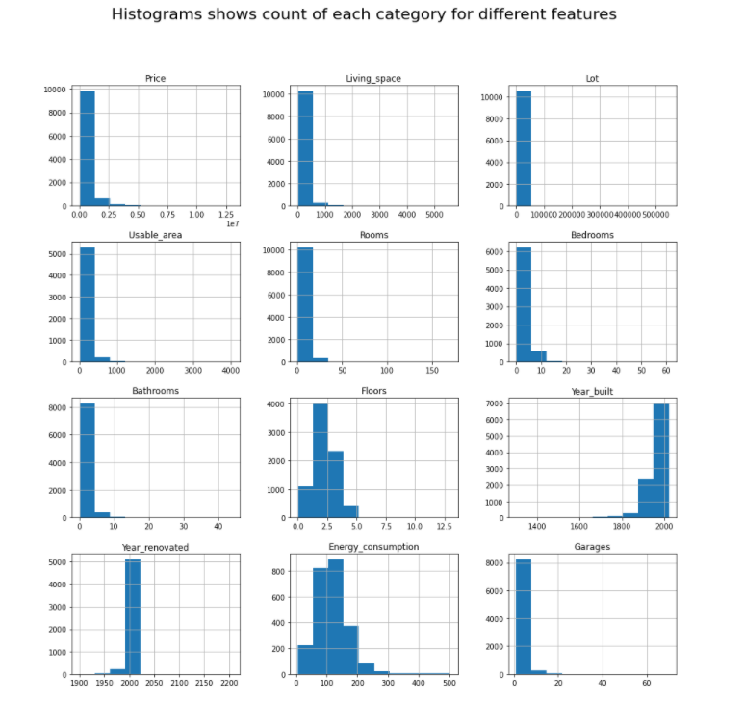
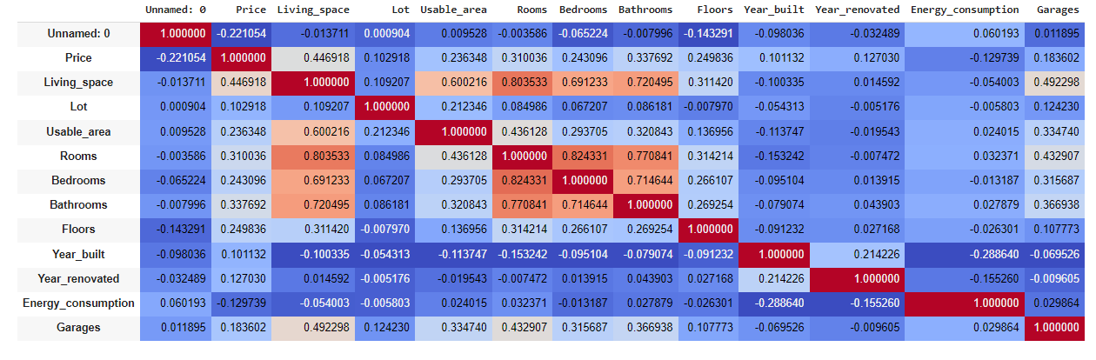
Exploratory Data Analysis (EDA)
correlation between all variables

Slide 7
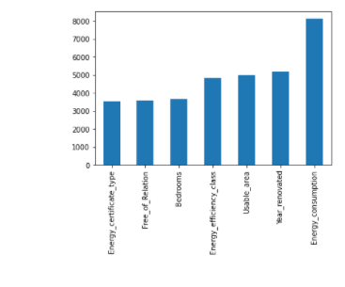
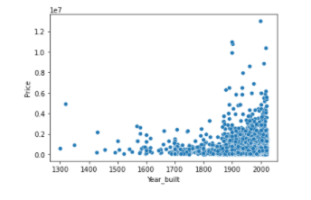
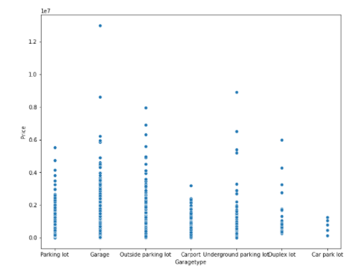
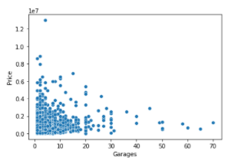
Exploratory Data Analysis (EDA)
Missing Values
Year of built Vs Price
Garage Type Vs Price
Garage Vs Price

Slide 8

Tools
NumPy
Pandas
Seaborn
Matplotlib
Scikit-learn

Slide 9

Machine Learning Model
Regression

Slide 10
Conclusion …
We can say that
After apply standard scaler the number of numerical become less and this help us in training our model
There is a correlation between living space, rooms , bathrooms, floors , state that affect with house price
After applying our model with all features, the number of error is decreased which mean that is a good model

Slide 11
Any Questions ?

